Slide 1
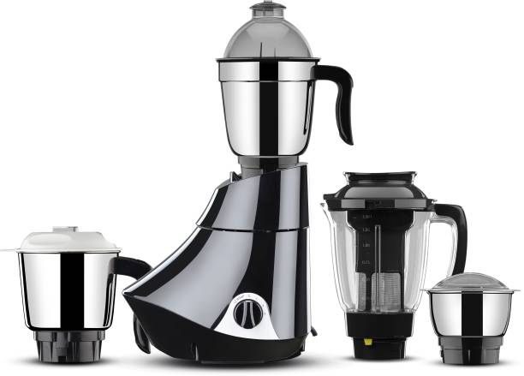
2 Years Limited Domestic Brand Warranty
750 W : Higher the Wattage
Stainless Steel Jars
Sales Package = Mixer Unit, 1 Juicer jar , 1 Liquid jar with lid, 1 Dry jar with lid, 1 Chutney jar with Lid, 1 Spatula and 1 User manual with Warranty Card.
Power Required = 220-240V, 50-60Hz
Grinding Jar Capacity = 0.75
Liquidizing Jar Capacity = 1.5
Chutney Jar Capacity = 0.4
Juice Extractor Jar Capacity = 0.5
Depth = 39
Height = 31 cm
Width = 24 cm
Weight = 4.65
₹2,699
Butterfly Rapid 4 Jar 750 watts 750 W Juicer Mixer Grinder (Black, 4 Jars)

Slide 2
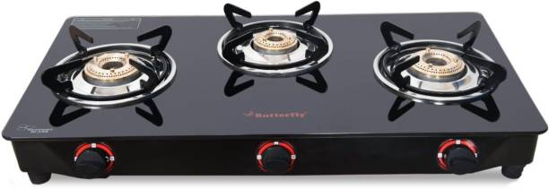
Model Name = Rapid 3 Burner
Model Number = 8906022173659
Body Material = Glass
Trivet Material = Stainless Steel
Shape = Rectangle
Width = 60 cm
Depth = 34.5 cm
Height = 10.5 cm
Weight = 4.4 kg
Warranty
Summary =1 Year Warranty from
the Date of Purchase
₹2,549
Butterfly Rapid 3 Burner Glass Manual Gas Stove (3 Burners)

Slide 3
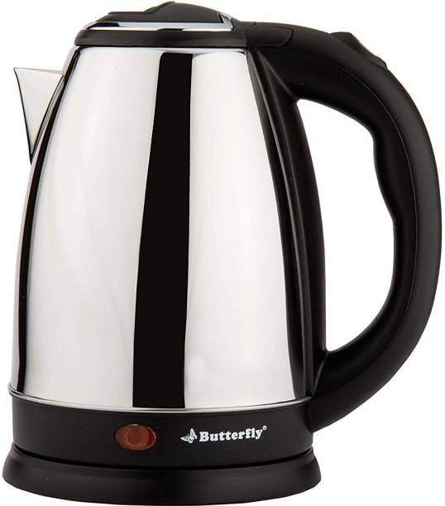
Warranty Summary = 1 Year Warranty
Model Name = EKN/RAPID
EKN/RAPID = EKN/RAPID
Operating Mode = Kettle
Specification = capacity: 1.8 litre | type: electric
₹899
Butterfly EKN 1.8 Electric Kettle (1.8 L, Black)

Slide 4
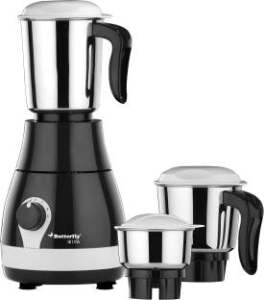
1 year limited domestic brand warranty on product and 2 year limited domestic brand warranty
500 W : Higher the Wattage, tougher the Juicing/Grinding
Grinding Jar Capacity = 1 L
Liquidizing Jar Capacity =1.5 L
Chutney Jar Capacity = 0.4 L
Depth = 32.5
Height = 22 cm
Width = 17 cm
Weight = 3.5 kg
₹1,699
Butterfly Arrow 500 W Mixer Grinder (Grey, 3 Jars)

Slide 5
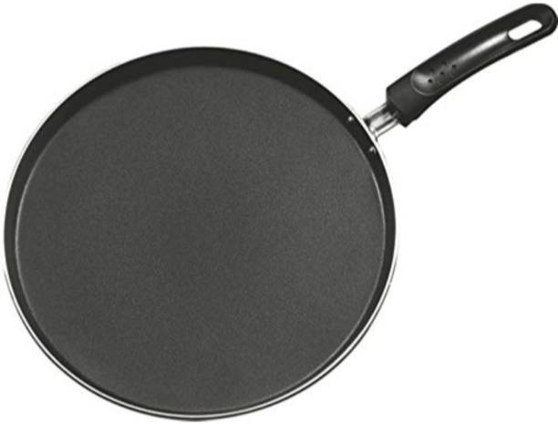
Made of = Aluminium
Type = Tawa
Non-stick, Dishwasher Safe
Induction Bottom
Capacity: 0.2 L
Diameter: 28 cm
1 Year warranty on product
Model Name = Rapid Omni Tawa 280 MM Induction
Model Number = 8906022176223
Weight = 0.67 g
₹429
Butterfly Rapid Omni Tawa 280 MM Induction Base Tawa 28 cm diameter (Aluminium, Non-stick, Induction Bottom)

Slide 6
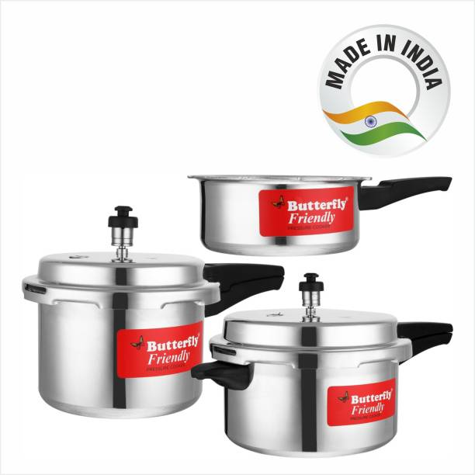
5 Year Warranty from the Date of Purchase
Made of: Aluminium
Pack of: 3
Capacity: 2 L, 3 L, 5 L
Lid Type: Outer Lid
Model Number : 8906022173604
Weight : 3.07 kg
₹1,699
Butterfly Friendly 2 L, 3 L, 5 L Pressure Cooker (Aluminium)

